Slide 1
A Markov model for ranking international cricket teams
Group - 9
Ashwin Sheoran
Harshit Garg
Yash Kumar
Vanisha Singh
Aaryan Verma
Vedant Patil
Shobhit Verma
GitHub Link : https://github.com/AshwinSheoran02/SPA-Final-Project-Group-9

Slide 2
Index
Abstract
Data
Motivations
Markov Chains
Model Building
ODI win probabilities
ODI team rankings for ICC vs Model
Test win probabilities
ICC vs Model team rankings for test cricket
Indian team analysed
Markov model for India vs Bangladesh
Conclusion

Slide 3
Abstract
Via this presentation, we aim to put forth a ranking system that covers the flaws of the present one followed by ICC
Sport will always be unpredictable but using our knowledge of stochastic processes, we aim to make predictions easier by determining potential highly challenging opponents for a particular team in head-to-head.
We attempt to do all this using Markov Chains and various already existing sporting models around it

Slide 4
Data
Modeled using top ten ranked nations registered under ICC as a reference point.
Data of matches last 20 games between each of the top 10 gathered from ICC website.
Considered the Last 20 games in each format of ODIs and Tests.
For India, considered their last 20 games against each opponent

Slide 5
Motivations
Stochastic processes, especially Markov Chains being applied in sports isn’t something out of the blue.
For baseball games:
Belman introduced a Markov Chain Model in 1976
Ursin in 2014
Bukiet et al in 1997 made use of Markov chains to find optimal batting orders.
Hirotsu and Wright in 2003 used Markov chains to evaluate optimal hitting strategies.
For cricket:
Clarke and Norman in 1998 used this to study decision making in cricket.
Colwell et al. made use of this in 1991 to model the outcomes between Australian and English cricket teams
Not just team sports, but individual ones like tennis and table tennis too have benefited from the use of Markov models

Slide 6
Why Markov?
Quite simply, entire past data can’t be used to predict the future.
Due to independence from past results and strict dependence on the recent past, Markov model is effective.
Maximum likelihood criterion used to estimate transition probabilities.

Slide 7
Markov Chains
A Markov chain or Markov process is a stochastic model describing a sequence of possible events in which the probability of each event depends only on the state attained in the previous event.
Discrete-time Markov chain
A discrete-time Markov chain (DTMC) is a sequence of random variables, known as a stochastic process, in which the value of the next variable depends only on the value of the current variable, and not any variables in the past.

Slide 8
Classification of States
Let {Xn,n ≥ 0} be a Markov chain with state space S. State j is said to be accessible from state i if p (n) i j > 0 for some n ≥ 0.
We say that two states i, j communicate if they are accessible from each other, i.e., p (n) i j > 0, p (m) j i > 0 for some n,m ≥ 0, and we write i ←→ j.

Slide 9
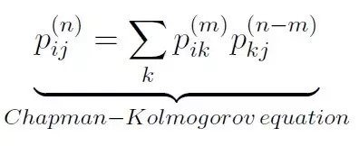
Chapman Kolmogorov Equation

Slide 10
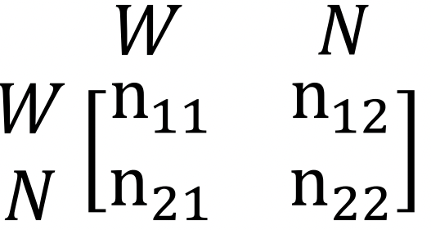
Model building
𝑋𝑛 is taken to be the 𝑛 th day performance of a team
Two states considered:
State 1-Team wins the match(W)
State 2-Team does not win(N)
𝑋𝑛 has a value from 1 to 2 on n-th day
Corresponding matrix for data recording:

Slide 11
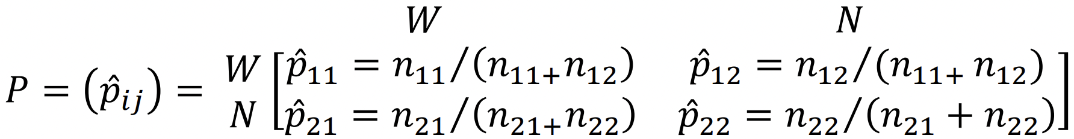
Model Building
Corresponding transition probability matrix:
steady-state probabilities:
𝜋𝑗 = lim 𝑃𝑖𝑗 𝑛 ∀𝑖,𝑗 ∈ 𝑆.
𝑛→∞

Slide 12
Win Probabilities for ODIs
Probabilities of winnings and not winning of each team in ODIs depending on the previous result and then calculating the general win and not winning probability of each team by taking the average.
TEAM | W->W | W->N | N->W | N->N | WIN | NOT WIN
NEW ZEALAND | 0.78 | 0.22 | 0.6 | 0.4 | 0.69 | 0.31
ENGLAND | 0.6 | 0.4 | 0.55 | 0.45 | 0.58 | 0.42
AUSTRALIA | 0.61 | 0.39 | 0.57 | 0.43 | 0.59 | 0.41
INDIA | 0.75 | 0.25 | 0.42 | 0.58 | 0.58 | 0.42
PAKISTAN | 0.58 | 0.42 | 0.46 | 0.54 | 0.52 | 0.48
SOUTH AFRICA | 0.33 | 0.66 | 0.7 | 0.3 | 0.51 | 0.49
BANGLADESH | 0.61 | 0.39 | 0.57 | 0.43 | 0.58 | 0.42
SRI LANKA | 0.44 | 0.56 | 0.5 | 0.5 | 0.46 | 0.54
AFGHANISTAN | 0.8 | 0.2 | 0.12 | 0.88 | 0.45 | 0.55

Slide 13
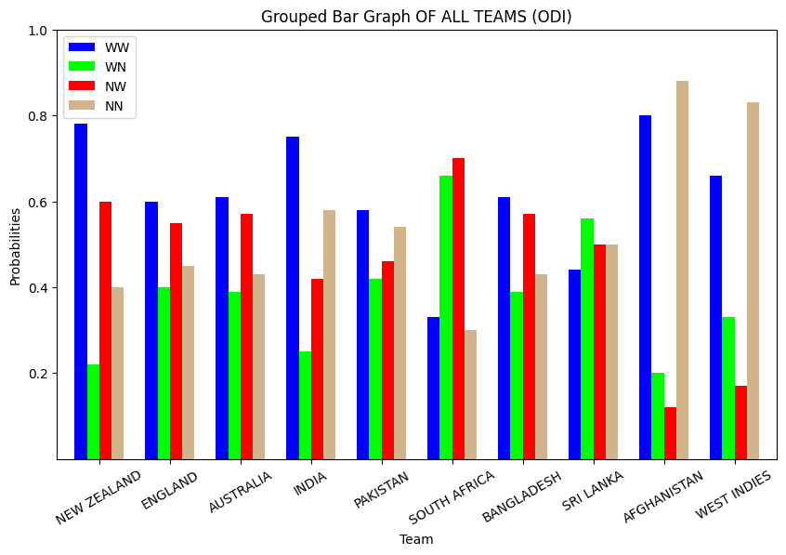
Win Probabilities for ODIs

Slide 14
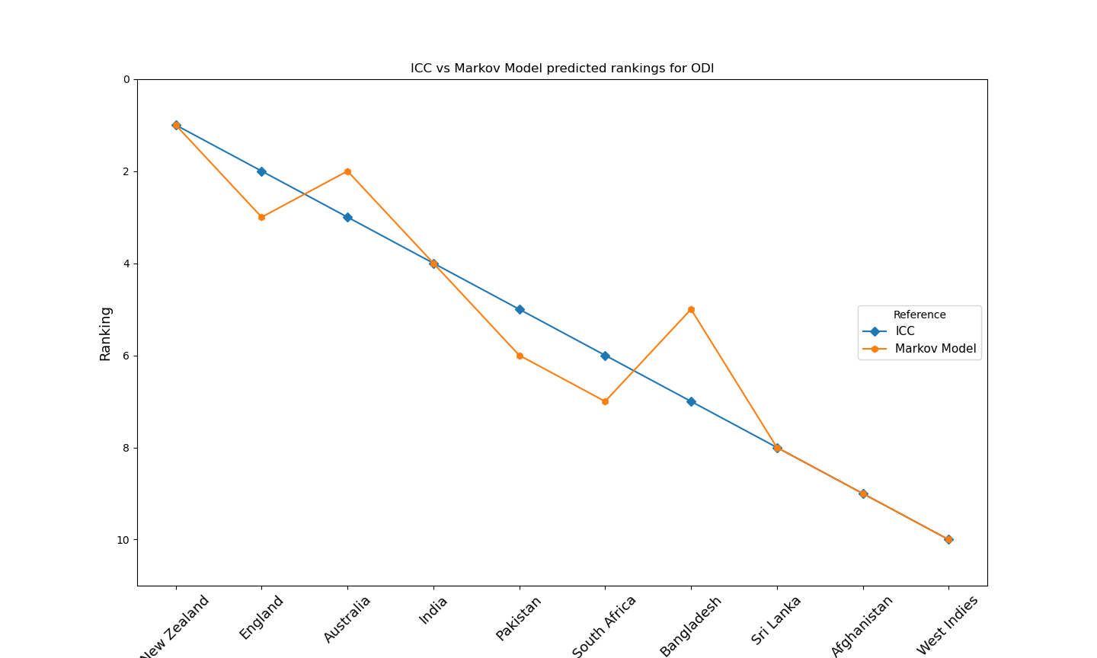
Difference in rankings for ODI
The attached plot shows the difference between the rankings made by our Markov model and those of ICC for One Day Internationals(ODI).
The existing ICC ODI ranking scheme is based on points, but the proposed Markov Chain ODI ranking scheme is based on steady state probabilities.

Slide 15
Win Probabilities for Tests
Probabilities of winnings and not winning of each team in Tests depending on the previous result and then calculating the general win and not winning probability of each team by taking the average.
TEAM | W->W | W->N | N->W | N->N | WIN | NOT WIN
AUSTRALIA | 0.64 | 0.36 | 0.57 | 0.43 | 0.61 | 0.39
INDIA | 0.45 | 0.55 | 0.7 | 0.3 | 0.58 | 0.42
SOUTH AFRICA | 0.7 | 0.3 | 0.42 | 0.58 | 0.56 | 0.44
ENGLAND | 0.57 | 0.43 | 0.25 | 0.75 | 0.41 | 0.59
NEW ZEALAND | 0.7 | 0.3 | 0.3 | 0.7 | 0.5 | 0.5
PAKISTAN | 0.6 | 0.4 | 0.22 | 0.78 | 0.41 | 0.59
SRI LANKA | 0.4 | 0.6 | 0.35 | 0.65 | 0.38 | 0.62
WEST INDIES | 0.5 | 0.5 | 0.23 | 0.77 | 0.37 | 0.63
BANGLADESH | 0 | 1 | 0.17 | 0.83 | 0.09 | 0.91

Slide 16
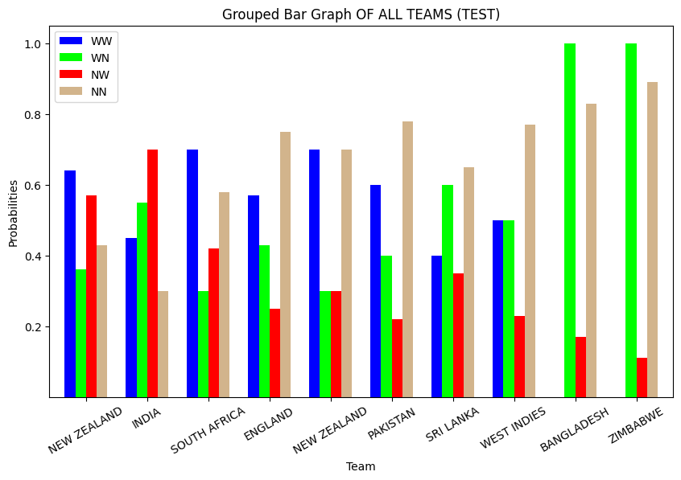
Win Probabilities for Tests

Slide 17
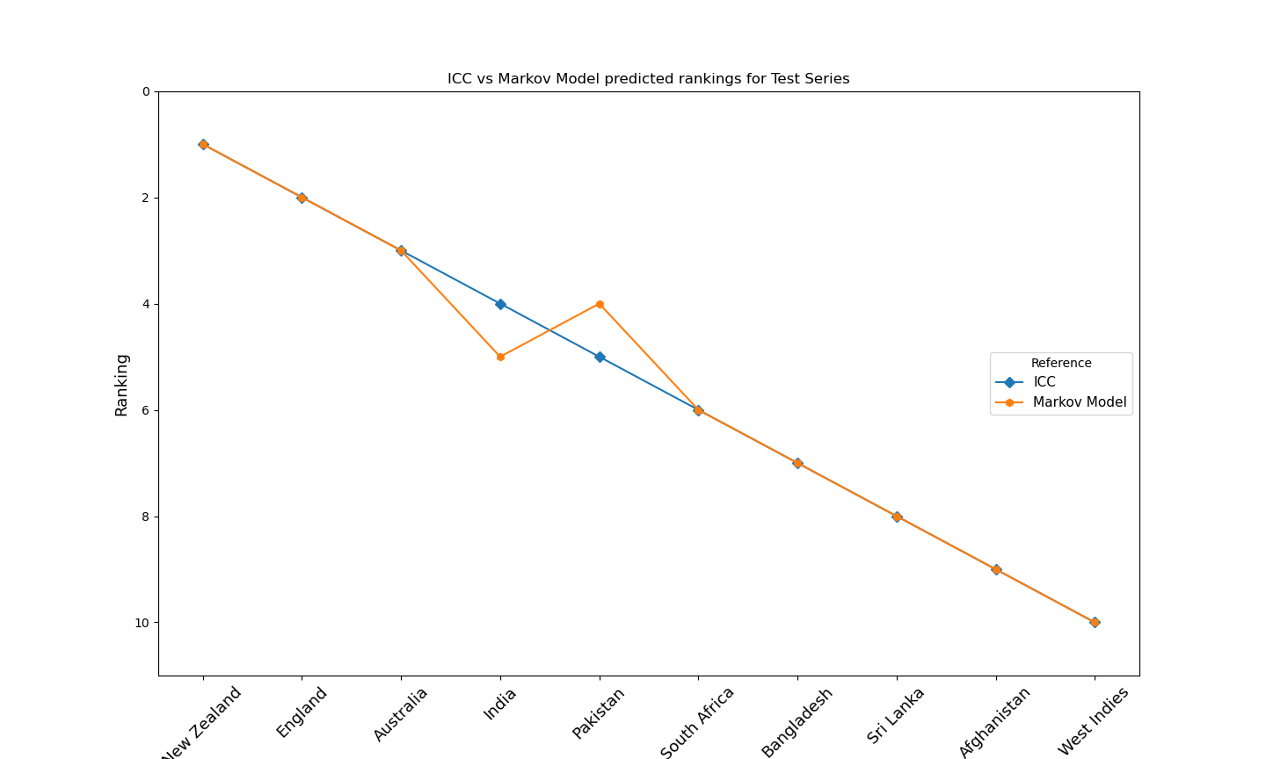
Difference in rankings for Test games
Test games provide a larger dataset to work with.
Attached plot shows ranking differences between ICC and Markov model for test games.
Barring two, both coincide for all teams.

Slide 18
Win Probabilities for India in ODIs
Probabilities of winnings and not winning of India against each team in ODIs depending on the previous result and then calculating the general win and not winning probability of each team by taking the average.
TEAM | WW | WN | NW | NN | WIN | NOT WIN
NEW ZEALAND | 0.43 | 0.57 | 0.55 | 0.45 | 0.49 | 0.51
ENGLAND | 0.45 | 0.55 | 0.57 | 0.43 | 0.51 | 0.49
AUSTRALIA | 0.54 | 0.46 | 0.62 | 0.38 | 0.58 | 0.42
PAKISTAN | 0.5 | 0.5 | 0.6 | 0.4 | 0.55 | 0.45
SOUTH AFRICA | 0.5 | 0.5 | 0.66 | 0.33 | 0.58 | 0.42
BANGLADESH | 0.8 | 0.2 | 0.66 | 0.33 | 0.73 | 0.27
SRI LANKA | 0.81 | 0.19 | 1 | 0 | 0.9 | 0.1
AFGHANISTAN | 0.66 | 0.33 | 1 | 0 | 0.83 | 0.17
WEST INDIES | 0.73 | 0.27 | 0.75 | 0.25 | 0.74 | 0.26

Slide 19
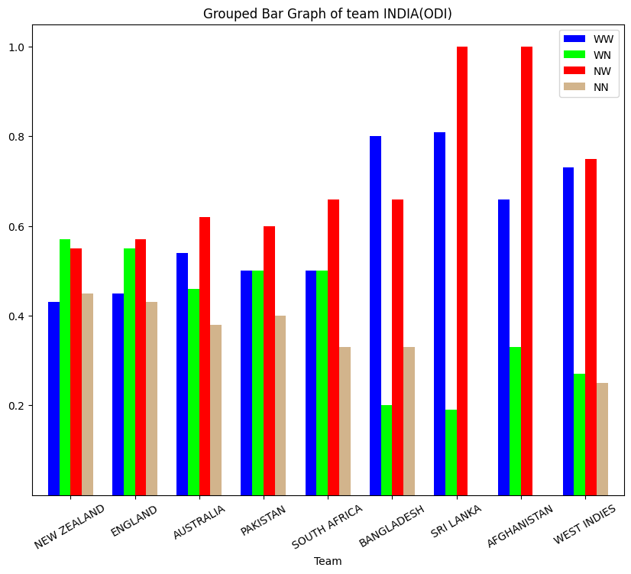
Win Probabilities for India in ODIs

Slide 20
Win Probabilities for India in Tests
Probabilities of winnings and not winning of India against each team in tests depending on the previous result and then calculating the general win and not winning probability of each team by taking the average.
TEAM | WW | WN | NW | NN | WIN | NOT WIN
AUSTRALIA | 0.44 | 0.56 | 0.54 | 0.46 | 0.49 | 0.51
SOUTH AFRICA | 0.45 | 0.55 | 0.55 | 0.45 | 0.5 | 0.5
ENGLAND | 0.5 | 0.5 | 0.4 | 0.6 | 0.45 | 0.55
NEW ZEALAND | 0.57 | 0.43 | 0.3 | 0.7 | 0.44 | 0.56
PAKISTAN | - | - | - | - | - | -
SRI LANKA | 0.46 | 0.54 | 0.7 | 0.3 | 0.58 | 0.42
WEST INDIES | 0.63 | 0.37 | 0.55 | 0.45 | 0.59 | 0.41
BANGLADESH | 0.75 | 0.25 | 1 | 0 | 0.88 | 0.12
ZIMBABWE | - | - | - | - | - | -

Slide 21
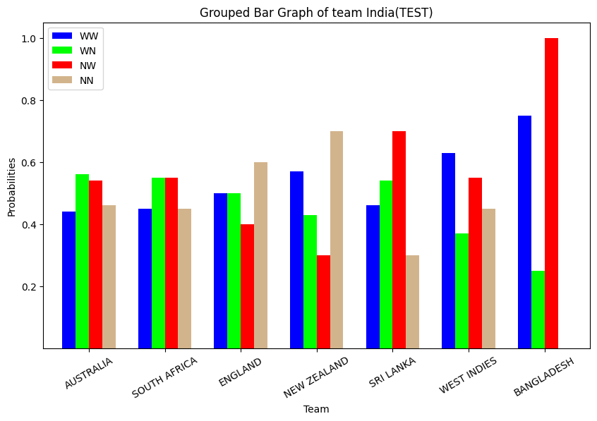
Win Probabilities for India in Tests

Slide 22
Homogenous Markov Chain
For the Markov chains used in prediction of matches we have made the assumption.
We have assumed a Homogenous Markov chain, this is because for calculating transition probabilities we have taken the data of last 40 matches of Indian team against each team, which is taken over ( last 45+ years ).
So using the law of large number, as our sample space is very big we have assumed that our transition probabilities is equal to actual probabilities and they do not change after 1-2 matches.

Slide 23
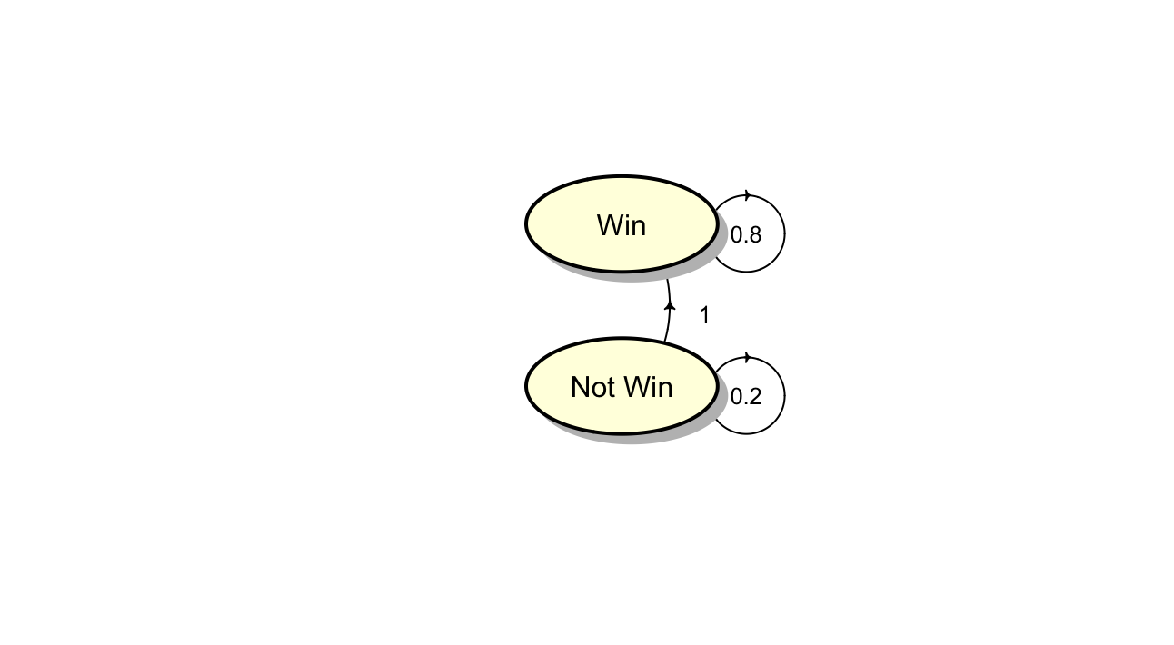
MARKOV MODEL FOR IND VS BAN ODI
The Markov chains for India against Bangladesh for ODI and Test
The Discrete time, Discrete space, Homogenous Markov Chain for India against Bangladesh for ODIs-
The Probabilities are for India.

Slide 24
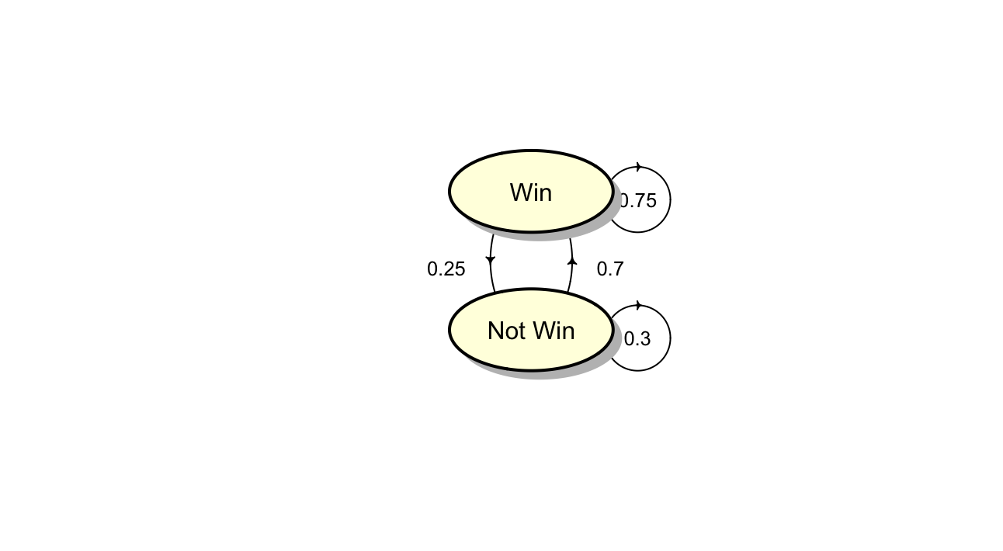
MARKOV MODEL FOR IND VS BAN Test
The Discrete time, Discrete space, Homogenous Markov Chain for India against Bangladesh for Tests

Slide 25
Prediction of Results of Indian ODI Matches
Matches | 1st Match | 2nd Match | 3rd Match
India vs NZ 2022 | NZ won | No Result | No Result
 |  | P(NN)<0.5 (Rain) | P(NN)<0.5 (Rain)
India vs SA 2022 | SA won | IND Won | IND Won
 |  | P(NW)>0.5 | P(WW)>=0.5
India vs ENG 2022 | IND won | ENG Won | IND Won
 |  | P(WN) > 0.5 | P(NW)>0.5
India vs WI 2022 | IND won | IND won | IND won
 |  | P(WW) > 0.5 | P(WW) > 0.5
India vs SL 2021 | IND won | IND won | SL won
 |  | P(WW)>0.5 | P(WN)<0.5 (Rain)
India vs ENG 2021 | IND won | ENG won | IND won
 |  | P(WN)>0.5 | P(NW)>0.5
India vs AUS 2020 | AUS won | AUS won | IND won
 |  | P(NN)<0.5 | P(NW)>0.5

Slide 26
Prediction of Results of Indian Test Matches
Matches | 1st Match | 2nd Match | 3rd Match | 4th Match | 5th Match
India vs NZ 2016 | IND won | IND won | IND won
 |  | P(WW)>0.5 | P(WW)>0.5
India vs ENG 2016 | Match Draw | IND won | IND won | IND won | IND won
 |  | P(NW)<0.5 | P(WW)>=0.5 | P(WW)>=0.5 | P(WW)>=0.5
India vs AUS 2017 | AUS won | IND won | Match Draw | IND won
 |  | P(NW)>0.5 | P(WN)>0.5 | P(NW)>0.5
India vs SL 2017 | Match Draw | IND won | Match Draw
 |  | P(NW)>0.5 | P(WN)>0.5
India vs SA 2018 | SA won | SA won | IND won
 |  | P(NN)>0.45 | P(NW)>0.5
India vs ENG 2018 | ENG won | ENG won | IND won | ENG won | ENG won
 |  | P(NN)>0.5 | P(NW)<0.5 | P(WN)>0.5 | P(NN)<0.5
India vs AUS 2018 | IND won | AUS won | IND won | Match Draw
 |  | P(WN)>0.5 | P(NW)>0.5 | P(WN)>0.5
India vs WI 2019 | IND won | WI won
 |  | P(WN)<0.5
India vs Ban 2019 | IND won | IND won
 |  | P(WW)>0.5
India vs NZ 2020 | NZ won | NZ won
 |  | P(NW) < 0.5
India vs SA 2021 | IND won | SA won | SA won
 |  | P(WN)>0.5 | P(NN)<0.5
India vs SL 2022 | IND won | IND won
 |  | P(WW)>0.5

Slide 27
Results
We are getting better results in Tests (Both rankings and prediction ) because Test is a game of 450 Overs and ODI is a game of 100 Overs.
Since the sample space in test i.e. Number of Overs increases, the teams that actually deserves to win is the winning team in most of the games.This is in accordance with the Law of Large Numbers.
So our model can predict Ranking and results of matches accurate to an extent.

Slide 28
Conclusion
So we observed that the original ranking of Test and ODI cricket, were very close to the ranking predicted through our probabilistic model, we also saw that the ranking of tests more accurate than ODIs as since we had a larger dataset (Sample Space) in case of Tests.
We can also predict the results of both ODI and Test matches by just knowing the result in the 1st match. We can predict the result with a accuracy of 70 % in ODIs and 75 % in Tests.
The not so perfect accuracy is because of the unpredictabilities like Rains, Injuries, medical issues like covid cases etc.

Slide 29





Programming languages and Libraries Used
Python
matplotlib
numpy
pandas
R
diagram library

Slide 30
References
https://www.sci.jfn.ac.lk
https://www.icc-cricket.com
http://www.howstat.com
https://madebyevan.com/fsm/
https://iconscout.com

Slide 31
Thank You

